Slide 1
Week 4.2 Clustering
Paul Immanuel J
Hope AI

Slide 2
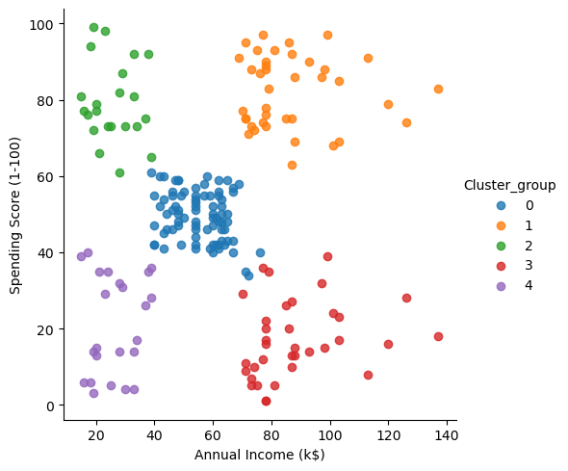
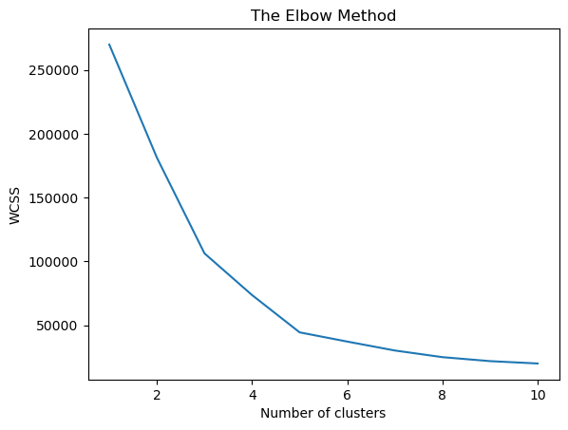
1. K-Means Clustering

Slide 3
1. K-Means Clustering
K-Means is an unsupervised machine learning algorithm used to group similar data points into clusters.
The algorithm partitions the dataset into K predefined clusters by minimizing the distance between data points and their respective cluster centroids.
How it works:
Select the number of clusters (K).
Initialize cluster centroids.
Assign data points to the nearest centroid.
Recalculate centroids.
Repeat until convergence.

Slide 4
1. K-Means Clustering
Result
The Elbow Method was used to determine the optimal number of clusters. The customers were successfully divided into five distinct groups.

Slide 5
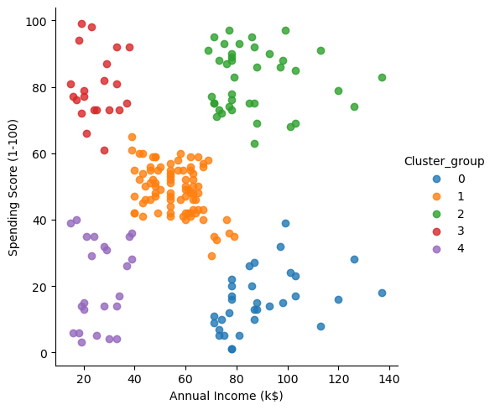
2. Agglomerative Clustering
Agglomerative Clustering is a hierarchical clustering technique that follows a bottom-up approach. Initially, each data point forms its own cluster, and clusters are merged step by step based on similarity.

Slide 6
2. Agglomerative Clustering
Working
Start with each data point as an individual cluster.
Calculate distances between clusters.
Merge the two closest clusters.
Continue merging until the required number of clusters is obtained.
Application
Agglomerative Clustering helps identify customer groups by analyzing similarities in purchasing behavior and income patterns.

Slide 7
2. Agglomerative Clustering
Result
The dendrogram was used to visualize the cluster formation process, and customers were grouped into meaningful clusters.

Slide 8
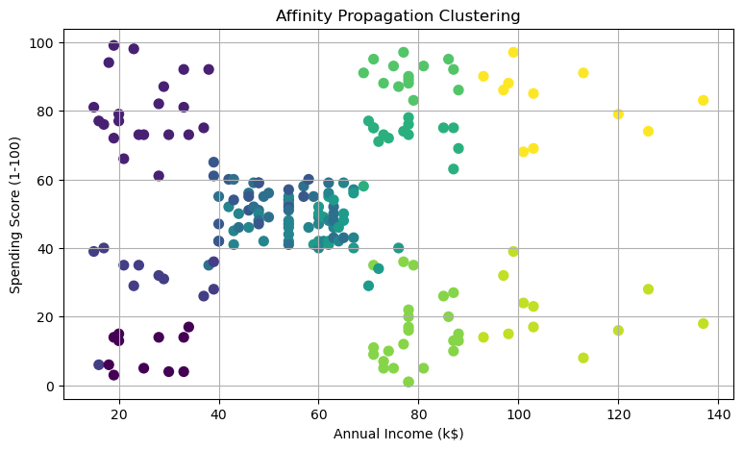
3. Affinity Propagation

Slide 9
3. Affinity Propagation
Affinity Propagation is a clustering algorithm that automatically determines the number of clusters by identifying representative data points called exemplars.
How it works:
Every data point is considered a potential cluster center.
Messages are exchanged between points.
Suitable exemplars are selected.
Clusters are formed around the exemplars.
Advantages
Does not require specifying the number of clusters.
Automatically finds cluster centers.
Effective for complex datasets.

Slide 10
3. Affinity Propagation
Result
The algorithm grouped customers based on their similarity and automatically determined cluster representatives.

Slide 11
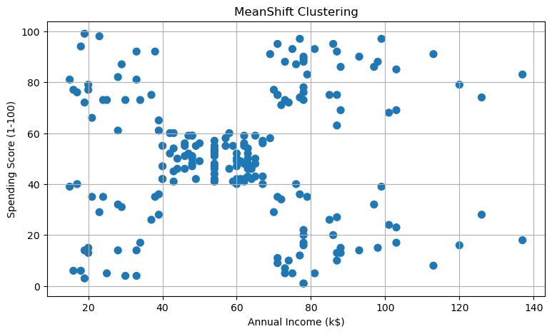
4. Mean Shift

Slide 12
4. Mean Shift
Mean Shift is a centroid-based clustering algorithm that identifies clusters by shifting data points toward regions with higher data density.
How it works:
Select a window around each point.
Compute the mean of points within the window.
Shift the window to the mean location.
Repeat until convergence.
Advantages:
Does not require specifying the number of clusters.
Can detect clusters of arbitrary shapes.
Useful for density-based grouping.

Slide 13
4. Mean Shift
Result:
Mean Shift successfully identified customer clusters by locating dense regions in the dataset.

Slide 14
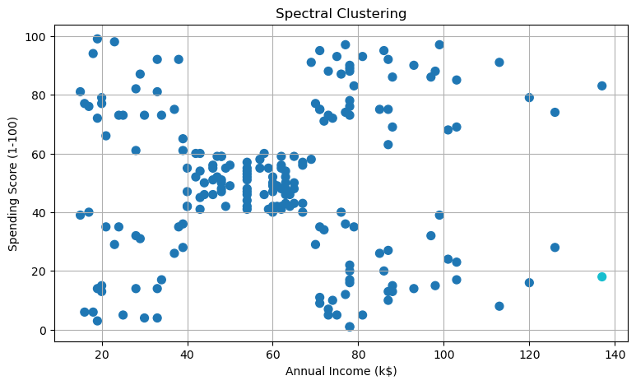
5. Spectral Clustering

Slide 15
5. Spectral Clustering
Spectral Clustering is a graph-based clustering algorithm that uses the eigenvalues of a similarity matrix to perform dimensionality reduction before clustering.
How it works:
Construct a similarity graph.
Compute the graph Laplacian.
Calculate eigenvectors.
Apply clustering on the transformed data.
Advantages:
Works well with non-linear data.
Effective for complex cluster structures.
Produces high-quality clusters.

Slide 16
5. Spectral Clustering
Result:
Spectral Clustering grouped customers into distinct segments based on similarity relationships within the dataset.

Slide 17
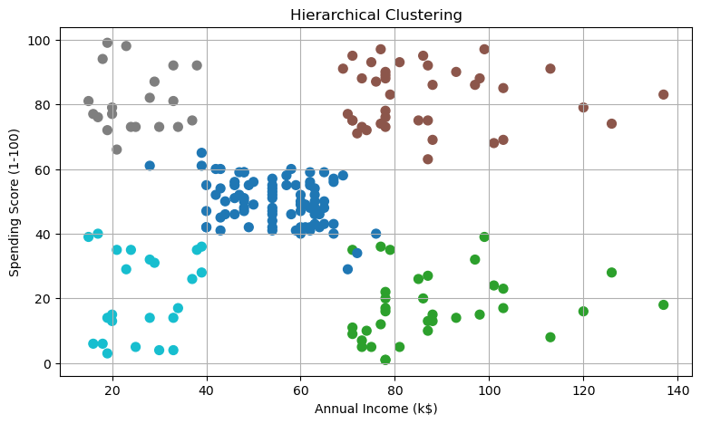
6. Hierarchical Clustering

Slide 18
6. Hierarchical Clustering
Hierarchical Clustering builds a hierarchy of clusters by either merging smaller clusters or splitting larger ones.
Agglomerative Clustering (Bottom-Up):
This approach begins with each data point treated as an individual cluster.
The algorithm then progressively combines the most similar clusters until the desired clustering structure is achieved.
Divisive Clustering (Top-Down):
In this method, all data points initially belong to a single cluster.
The algorithm repeatedly divides clusters into smaller groups based on their differences, creating a hierarchical structure.

Slide 19
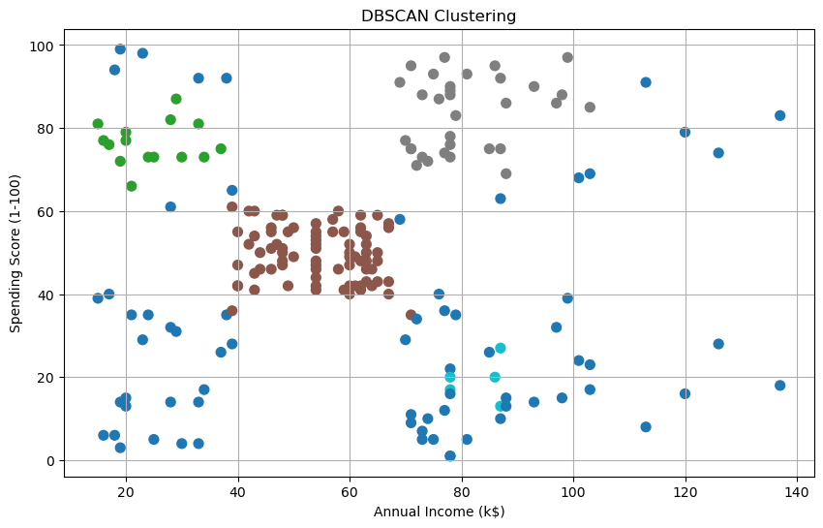
7. DBScan Clustering

Slide 20
7. DBScan Clustering
DBSCAN is a density-based clustering algorithm that forms clusters by connecting points located close to one another.
Points that do not belong to any dense region are treated as noise or outliers.
Key parameters:
eps: Defines the neighborhood radius around a point.
min_samples: Specifies the minimum number of points required within that radius for a region to be considered dense.
The algorithm evaluates each point by looking at the number of neighboring points within the eps distance.
If a point has at least min_samples neighbors, it becomes part of a cluster; otherwise,
it may be labeled as a border point or noise, depending on its surroundings.

Slide 21
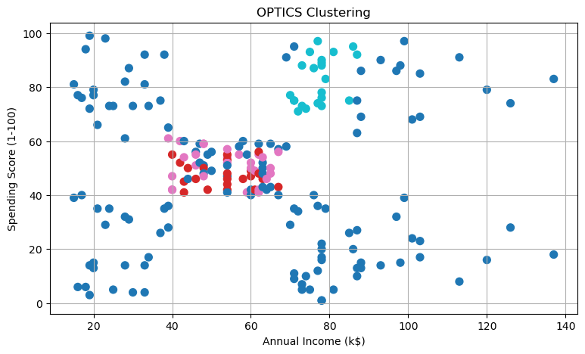
8. Optics Clustering

Slide 22
8. Optics Clustering
It is a density-based clustering technique designed to identify clusters of varying densities within a dataset.
Similar to DBSCAN, OPTICS groups points that are densely packed together while treating points in sparse regions as potential noise or outliers.
Instead of directly assigning points to clusters, OPTICS generates an ordered sequence of data points that reflects the underlying density-based structure of the dataset.
Advantages:
The algorithm produces a reachability plot, which helps visualize changes in density across the data.
This plot can be used to identify meaningful clusters and understand the overall clustering pattern.

Slide 23
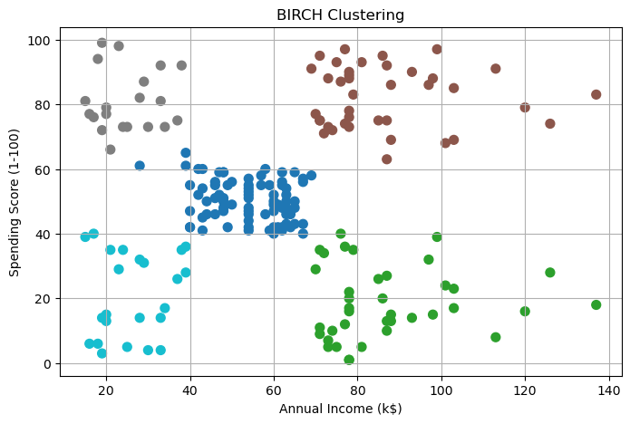
9. Birch Clustering

Slide 24
9. Birch Clustering
Builds a compact CF (Clustering Feature) tree by incrementally processing data points.
Organizes data into a hierarchical structure, making it efficient for large datasets.
Stores data as summarized cluster representations rather than individual points.
Performs the final clustering step using the information contained in the leaf nodes of the CF tree.

Slide 25
Thank You

